Slide 1
Investment Portfolio Optimization
Michał Podsiadło
WhyR?
28th September 2019
Warsaw

Slide 2
Plan Of Presentation
Intro
Idea
Industry Specification
Assets Specification
Packages & Libraries
Data Set & ETL
Data Set Specification
ETL Methodology
Key Variables
Price Predictions
Regression Metrics
Prediction Models
Modelling Outcomes
Portfolio Optimization
Key Formulas
Business Scenarios
Optimization Outcomes
Summary
Short & Concise
Sources

Slide 3
INTRO

Slide 4
Idea
The presentation's goal is just to explain the problem of constructing efficient portfolios and show how to impelement a solution for the best fitted portfolios which will give maximized returns with minimized risks.
Based on the postgraduate thesis - Investment Portfolio Optimization based on ETF funds and traditional Mutual funds

Slide 5
Industry Specification (1/2)
Processing of collected data
ETL
Various data sources
NLP
Automated portfolio construction
Analytical tools
Portfolio optimization tools
Financial modelling
Dashboards / KPI / portfolio performance

Slide 6
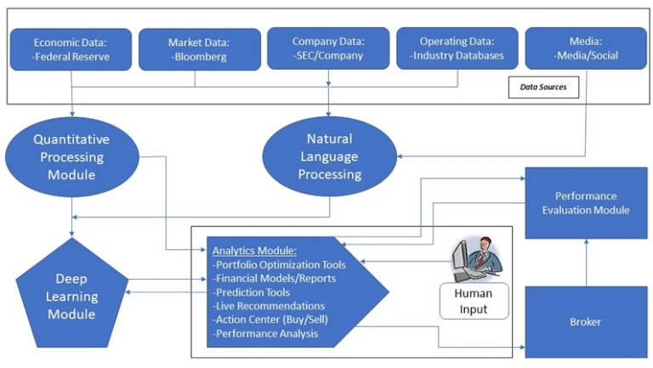
SOURCE: https://blogs.cfainstitute.org/investor/2018/02/08/data-science-will-transform-the-investment-industry-are-you-prepared/

Slide 7
Industry Specification (2/2)
Modern theory of portfolio construction
Efficient frontier
Maximized returns
Minimized risks
IPS (Investment Policy Statement)
individual investor needs
tailored assets & portfolio
any exceptions must be discussed

Slide 8
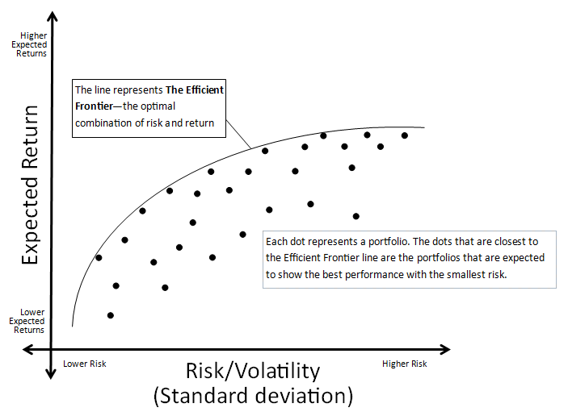
SOURCE: http://www.gettingyourich.com/blog/what-is-the-efficient-frontier-theory

Slide 9
Assets Specification (1/3)
Bonds
Quite “safe”
Form of loan to the companies, governments, etc.
Coupon or non-coupon
Ratings
Investment grade
Non-investment grade

Slide 10
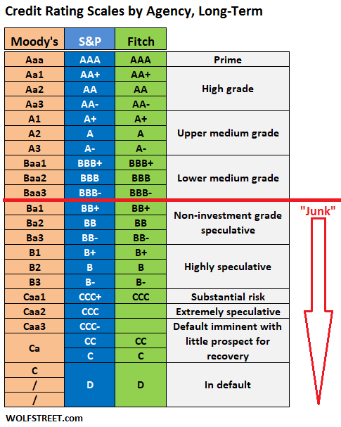
SOURCE: https://wolfstreet.com/credit-rating-scales-by-moodys-sp-and-fitch/

Slide 11
Assets Specification (2/3)
Equities
Risky
Part of companies' finances
Possibility of dividends
Accounting principle
Assets = Liabilities + Equities
Sectors
Along Global Industry Classification Standard

Slide 12
Assets Specification (3/3)
Sectors by Global Industry Classification Standard
Energy
Materials
Industrials
Consumer Discretionary
Consumer Staples
Health Care
Financials
Information Technology
Communication Services
Utilities
Real Estate

Slide 13
Packages & Libraries
Caret
Well known
Multiple models
Predictions
PortfolioOptimizer
Very simple, minimalistic
Contains portfolios as separate objects
You just only add up constraints, objectives

Slide 14
Data Set & ETL

Slide 15
Data Set Specification
Data sets from Kaggle
Mutual Funds and ETFs
As at the 03/05/2019
Based on Yahoo Finance
Contain
General (basic) details
Sector weights (equities)
Rating weights (bonds)
Return rates for each year
Return rates for certain asset classes
Morningstar's portfolio classifications
Bonds maturities
ETFs - CSV file [;]
2.352 instances (rows)
104 attributes (columns)
Mutual Funds - CSV file [;]
25.308 instances (rows)
125 attributes (columns)

Slide 16
ETL Methodology
Deleted “certain” ratios and measures
Remained only factual data with weights and returns
Weights had to be adjusted to percents - e.g. 6.93 → 0.0693
Weights had to be adjusted in the context of the whole portfolio, not the certain asset class
Returns were adjusted in context of certain assets and asset classes - it will be needed in Portfolio Optimization

Slide 17
Key Variables (1/2)
General specific variables
Categorization
investment
size
Asset classes
portfolio_stocks
portfolio_bonds
Return rates
fund_return_2018
fund_return_2017
fund_return_2016
fund_return_2015
fund_return_2014
fund_return_2013
fund_return_2012
fund_return_2011
fund_return_2010

Slide 18
Key Variables (2/2)
Sectors (Equities)
basic_materials
consumer_cyclical
financial_services
real_estate
consumer_defensive
healthcare
utilities
communication_services
energy
industrials
technology
Ratings (Bonds)
rating_aaa
rating_aa
rating_a
rating_bbb
rating_bb
rating_b
rating_below_b
rating_others

Slide 19
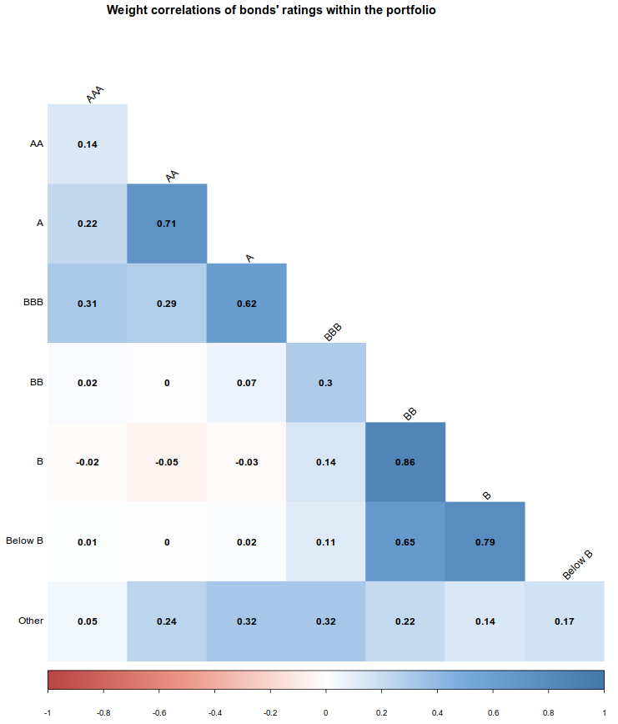

Slide 20
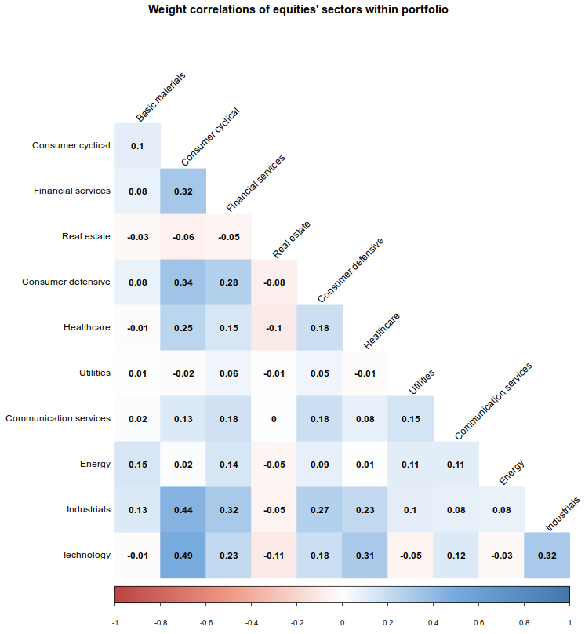

Slide 21
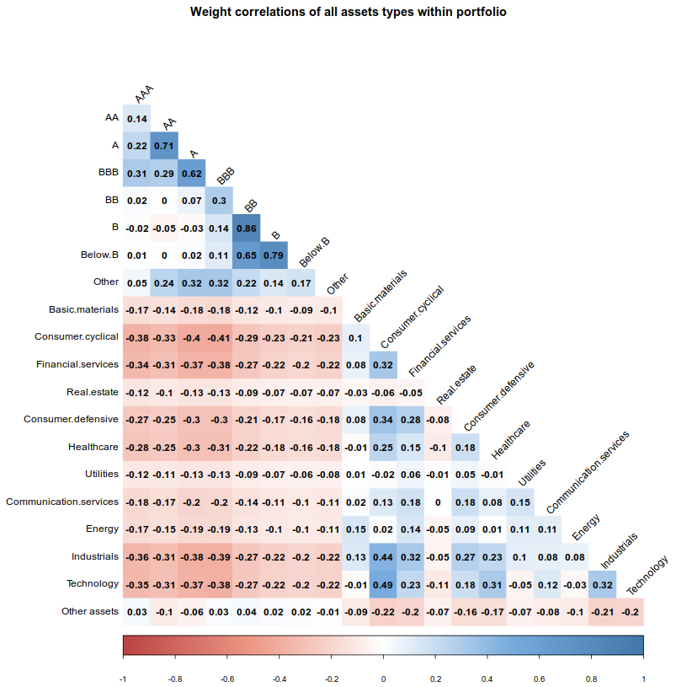

Slide 22
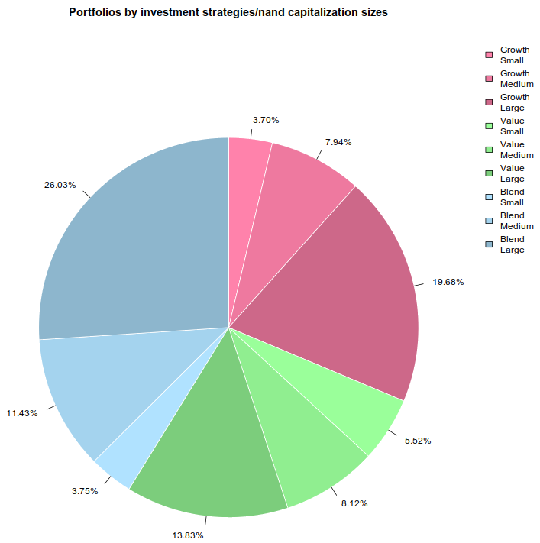

Slide 23
Price Predictions

Slide 24
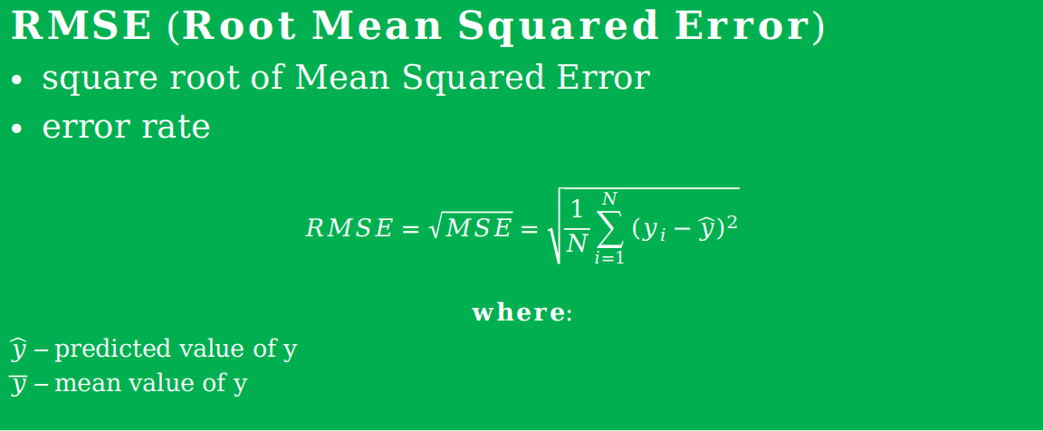
Regression Metrics (1/3)
$$RMSE (Root Mean Squared Error)$$
$square root of Mean Squared Error$
$error rate$
$$RMSE=\sqrt{MSE}=\sqrt{\frac{1}{N}\sum_{i=1}^{N}{{(y_{i}−\hat{y})}^{2}}}$$
$$where:$$
$\hat{y}$ – predicted value of y
$\overline{y}$ – mean value of y

Slide 25
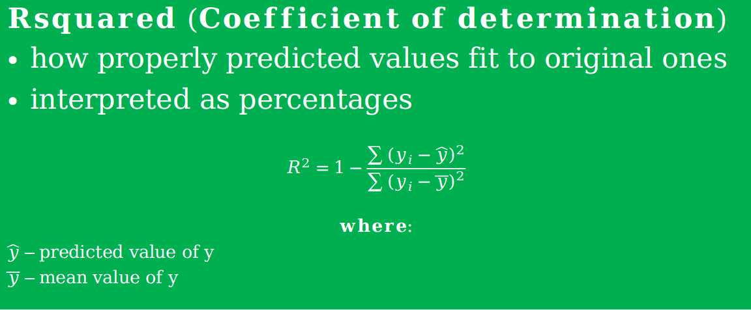
Regression Metrics (2/3)
$$Rsquared (Coefficient of determination)$$
$how properly predicted values fit to original ones$
$interpreted as percentages$
$$R^{2}=1−\frac{\sum{{(y_{i}−\hat{y})}^{2}}}{\sum{{(y_{i}−\overline{y})}^{2}}}$$
$$where:$$
$\hat{y}$ – predicted value of y
$\overline{y}$ – mean value of y

Slide 26
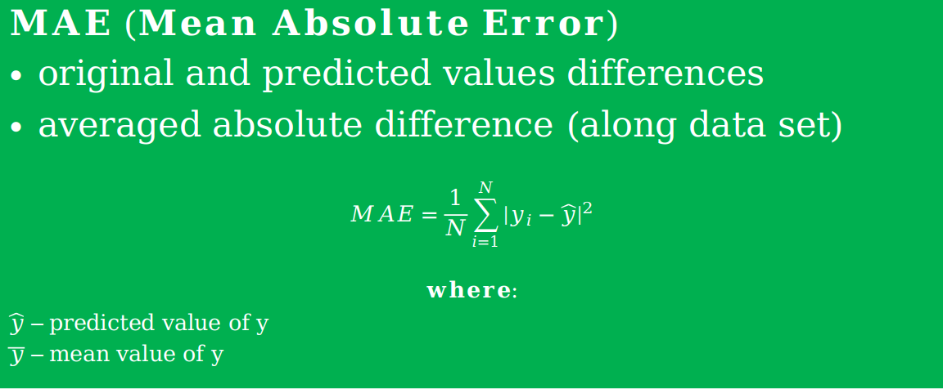
Regression Metrics (3/3)
$$MAE (Mean Absolute Error)$$
$original and predicted values differences$
$averaged absolute difference (along data set)$
$$MAE=\frac{1}{N}\sum_{i=1}^{N}{{\left|y_{i}−\hat{y}\right|}^{2}}$$
$$where:$$
$\hat{y}$ – predicted value of y
$\overline{y}$ – mean value of y

Slide 27
Prediction Models
Time frames
2010 - 2018
Linearity is obvious - not only for prediction, but also for portfolio construction
135 Possible Linear Models to use
Chosen only 1 model
RSquared used in decision making

Slide 28
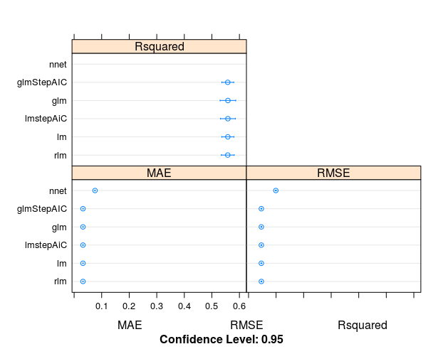
Modelling Outcomes

Slide 29
Modelling Outcomes
Linear Regression
8867 samples
8 predictor
No pre-processing
Resampling: Cross-Validated (10 fold)
Summary of sample sizes: 7982, 7980, 7979, 7981, 7980, 7981, ...
Resampling results:
RMSE Rsquared MAE
0.0464308 0.5579009 0.03218755

Slide 30
Portfolio Optimization

Slide 31
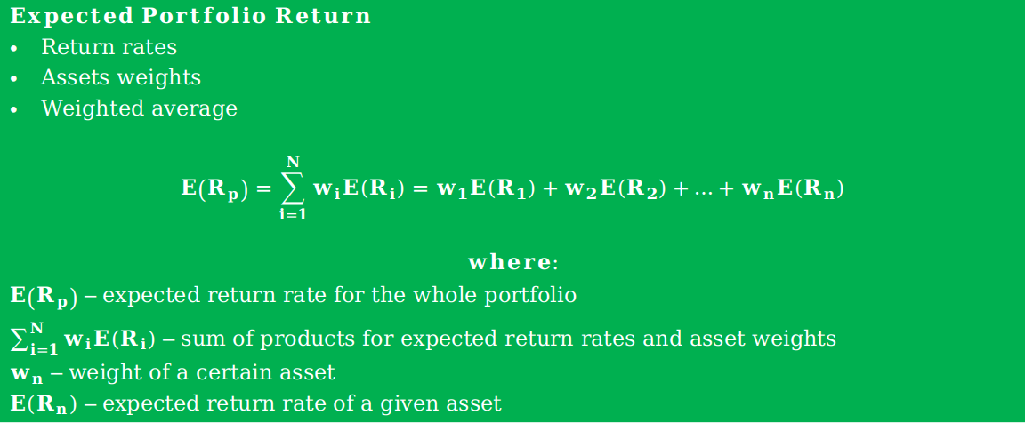
Key Formulas (1/2)
$$Expected Portfolio Return$$
$Return rates$
$Assets weights$
$Weighted average$
$$E\left(R_{p}\right)=\sum_{i=1}^{N}{w_{i}E\left(R_{i}\right)}=w_{1}E\left(R_{1}\right)+w_{2}E\left(R_{2}\right)+…+w_{n}E\left(R_{n}\right)$$
$$where:$$
$E\left(R_{p}\right)$ – expected return rate for the whole portfolio
$\sum_{i=1}^{N}{w_{i}E\left(R_{i}\right)}$ – sum of products for expected return rates and asset weights
$w_{n}$ – weight of a certain asset
$E\left(R_{n}\right)$ – expected return rate of a given asset

Slide 32
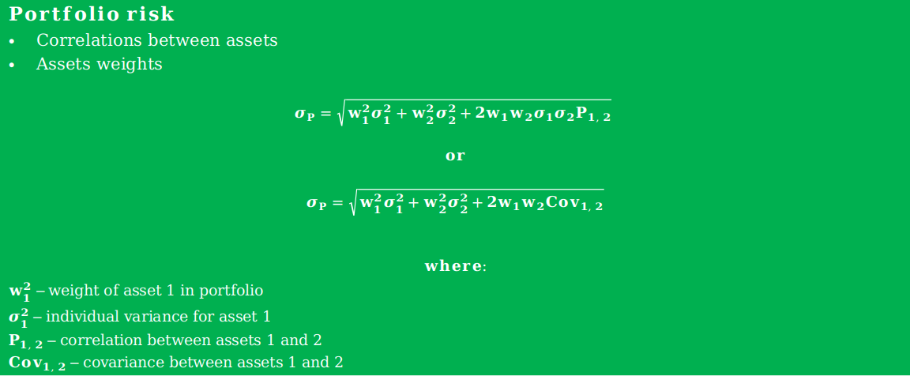
Key Formulas (2/2)
$$Portfolio risk$$
$Correlations between assets$
$Assets weights$
$$σ_{P}=\sqrt{w_{1}^{2}σ_{1}^{2}+w_{2}^{2}σ_{2}^{2}+2w_{1}w_{2}σ_{1}σ_{2}P_{1, 2}}$$
$$or$$
$$σ_{P}=\sqrt{w_{1}^{2}σ_{1}^{2}+w_{2}^{2}σ_{2}^{2}+2w_{1}w_{2}{Cov}_{1, 2}}$$
$$where:$$
$w_{1}^{2}$ – weight of asset 1 in portfolio
$σ_{1}^{2}$ – individual variance for asset 1
$P_{1, 2}$ – correlation between assets 1 and 2
${Cov}_{1, 2}$ – covariance between assets 1 and 2

Slide 33
Business Scenarios
There can be many and lots of combinations or needs
depend on customer's needs and market flavours
by portfolio / capitalization sizes
small
medium
large
by investment strategy
value
growth
blend

Slide 34
Optimization Outcomes
 | Strategy - GROWTH Size - SMALL | Strategy - GROWTH Size - MEDIUM | Strategy - GROWTH Size - LARGE | Strategy - VALUE Size - SMALL | Strategy - VALUE Size - MEDIUM | Strategy - VALUE Size - LARGE | Strategy - BLEND Size - SMALL | Strategy - BLEND Size - MEDIUM | Strategy - BLEND Size - LARGE
OTHER ASSETS | 0,0000 | 0,0000 | 0,0000 | 0,0000 | 0,0000 | 0,0000 | 0,0000 | 0,0000 | 0,0000
Basic materials | 0,0000 | 0,0000 | 0,0000 | 0,0000 | 0,0000 | 0,0000 | 0,0000 | 0,0000 | 0,0000
Consumer cyclical | 0,0000 | 0,0000 | 0,0000 | 0,0000 | 0,0000 | 0,0000 | 0,0000 | 0,0000 | 0,0000
Financial services | 0,0000 | 0,0000 | 0,0000 | 0,0000 | 0,0000 | 0,0000 | 0,0000 | 0,0000 | 0,0000
Real estate | 0,0000 | 0,0000 | 0,0000 | 0,0000 | 0,0000 | 0,0000 | 0,0000 | 0,0000 | 0,0000
Consumer defensive | 0,0000 | 0,0000 | 0,0000 | 0,0000 | 0,0000 | 0,0000 | 0,0000 | 0,0000 | 0,0000
Healthcare | 0,0000 | 0,0000 | 0,0000 | 0,0000 | 0,0000 | 0,0000 | 0,0000 | 0,0000 | 0,0000
Utilities | 0,0000 | 0,0000 | 0,0000 | 0,0000 | 0,0000 | 0,0000 | 0,0000 | 0,0000 | 0,0000
Communication services | 0,0000 | 0,0000 | 0,0000 | 0,6500 | 0,0000 | 0,0000 | 0,0000 | 0,0000 | 0,0000
Energy | 0,0000 | 0,0000 | 0,0000 | 0,0000 | 0,0000 | 0,0000 | 0,0000 | 0,0000 | 0,0000
Industrials | 0,0000 | 0,0000 | 0,0000 | 0,0000 | 0,0000 | 0,0000 | 0,0000 | 0,0000 | 0,0000
Technology | 0,0000 | 0,0000 | 0,0000 | 0,0000 | 0,0000 | 0,0000 | 0,0000 | 0,0000 | 0,0000
AAA | 0,0000 | 0,0000 | 0,0000 | 0,0000 | 0,0000 | 0,0000 | 0,0000 | 0,0000 | 0,0000
AA | 0,3499 | 0,6500 | 0,0000 | 0,3499 | 0,6500 | 0,6500 | 0,6500 | 0,6500 | 0,3499
A | 0,0000 | 0,3501 | 0,0000 | 0,0000 | 0,0000 | 0,0000 | 0,0000 | 0,3501 | 0,0000
BBB | 0,0000 | 0,0000 | 0,0000 | 0,0000 | 0,0000 | 0,0000 | 0,0000 | 0,0000 | 0,0000
BB | 0,0000 | 0,0000 | 0,0000 | 0,0000 | 0,0000 | 0,0000 | 0,0000 | 0,0000 | 0,0000
B | 0,0000 | 0,0000 | 0,0000 | 0,0000 | 0,0000 | 0,0000 | 0,0000 | 0,0000 | 0,0000
Below B | 0,0000 | 0,0000 | 0,6500 | 0,0000 | 0,0000 | 0,0000 | 0,0000 | 0,0000 | 0,6500
Other | 0,6500 | 0,0000 | 0,3499 | 0,0000 | 0,3499 | 0,3499 | 0,3499 | 0,0000 | 0,0000

Slide 35
Summary

Slide 36
Short & Concise
Diversification does matter!
Both for assets and asset classes
We want maximized returns and minimized risks
Only proper selection of weights and asset classes can minimize and dilute risk of invested capital
Capitalization size and investment strategy do matter!

Slide 37
Sources (1/2)
Andrecut, M. (2013). Portfolio Optimization in R. Unlimited Analytics Inc.
Balcewicz, J. (2019). Cyberpolicy NASK. Retrieved from https://cyberpolicy.nask.pl/sztuczna-inteligencja-godna-zaufania-rekomendacje-grupy-ekspertow-komisji-europejskiej/
Bennett, R. (2018). Introduction to PortfolioAnalytics.
Everitt, B. S., & Hothorn, T. (2006). A Handbook of Statistical Analyses Using R. Chapman & Hall-CRC.
Frątczak, E. (2012). W Zaawansowane metody analiz statystycznych (strony 45-47). Warszawa: Oficyna Wydawnicza SGH.
Frątczak, E. (2015). In Statistics for Management and Economics (pp. 409-412). Warszawa: Oficyna Wydawnicza SGH.
Frątczak, E. i Korczyński, A. (2014). Statystyka od podstaw z systemem SAS wersja 9.2 i 9.3. Warszawa: Oficyna Wydawnicza SGH.
Garnry, P. (2017). Skarbiec. Retrieved from https://www.skarbiec.biz/inwestycje/gielda/zmienic-portfel-bardziej-defensywny.html
Grzegorzewski, P., Gagolewski, M. i Bobecka-Wesołowska, K. (2014). Wnioskowanie statystyczne z wykorzystaniem srodowiska R. Warszawa: Biuro ds. Projektu „Program Rozwojowy Politechniki Warszawskiej”.
Harrington, C. (2017). CFA Institute. Retrieved from https://www.cfainstitute.org/en/research/cfa-magazine/2017/speaking-data-science-with-an-investment-accent
IShares. (2019). Retrieved from https://www.ishares.com/us/about-etfs/what-is-an-etf

Slide 38
Sources (2/2)
KupAkcje.pl. (2007). Retrieved from http://kupakcje.pl/?p=159
Leone, S. (2019). Kaggle. Retrieved from https://www.kaggle.com/stefanoleone992/mutual-funds-and-etfs
Mankiw, G. N., & Taylor, M. P. (2016). Makroekonomia. Warszawa: Polskie Wydawnictwo Ekonomiczne.
Panimalar, A., Shree, V., & Kathrine, V. (2017). Irjet. Retrieved from https://www.irjet.net/archives/V4/i9/IRJET-V4I957.pdf
Przanowski, K. (2014). Credit Scoring w erze Big-Data. Warszawa: Oficyna Wydawnicza SGH.
Przanowski, K. (2015). In Credit Scoring – studia przypadków procesów biznesowych (p. 36). Warszawa: Oficyna Wydawnicza SGH.
Saidov, U. (2018). CFA Institute. Retrieved from https://blogs.cfainstitute.org/investor/2018/02/08/data-science-will-transform-the-investment-industry-are-you-prepared/
Świerkot, M. (2011). Bankier. Retrieved from https://www.bankier.pl/wiadomosc/Ratingi-Wielkiej-Trojki-hustaja-gieldami-2393655.html
Świerkot, M. (2012). Bankier. Retrieved from https://www.bankier.pl/wiadomosc/Przeglad-inwestycji-Warrena-Buffetta-2668741.html
Wolfstreet (2019). Retrieved from https://wolfstreet.com/credit-rating-scales-by-moodys-sp-and-fitch/
Würtz, D., Setz, T., Chalabi, Y., Lam, L., & Ellis, A. (2015). Portfolio Optimization with R-Rmetrics. Rmetrics Association & Finance Online Publishing.

Slide 39

THANK YOU FOR ATTENTION :)
Contact details:
name: Michał Podsiadło
mobile: 506-962-069
mail: Michal.Podsiadlo.88@gmail.com
insta: von_sexcel
github: github.com/Ravn88
kaggle: kaggle.com/ravn88

